Slide 1
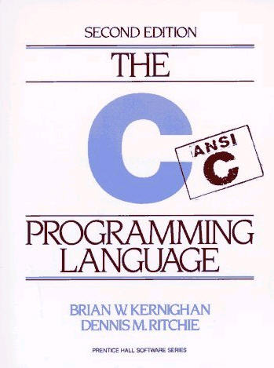
Review of Scientific
Programming in C
Derrick Kearney
HUBzero® Platform for Scientific Collaboration
Purdue University
Original slides by Michael McLennan
This work licensed under
Creative Commons
See license online:
by-nc-sa/3.0

Slide 2

Monte Carlo Simulator
¢
Simulate by randomly generating
thousands of tracks
¢
50/50 chance
left or right at
each peg
?
count
bucket

Slide 3
Plinko Simulator in C
file: plinko.c
#include <stdio.h>
#include <stdlib.h>
#include <math.h>
#define LEVELS 9
int
main(int argc, char **argv)
{
int max, drop, i, pos, count[LEVELS+1];
double rnum;
printf("number of drops?\n");
if (scanf("%d", &max) != 1) {
fprintf(stderr,"bad number!\n");
exit(1);
}
for (i=0; i < LEVELS+1; i++) {
count[i] = 0;
}
Definitions of functions
we’ll use below
Constant value,
substituted wherever
it is referenced in the
rest of the file

Slide 4
Plinko Simulator in C
file: plinko.c
#include <stdio.h>
#include <stdlib.h>
#include <math.h>
#define LEVELS 9
int
main(int argc, char **argv)
{
int max, drop, i, pos, count[LEVELS+1];
double rnum;
printf("number of drops?\n");
if (scanf("%d", &max) != 1) {
fprintf(stderr,"bad number!\n");
exit(1);
}
for (i=0; i < LEVELS+1; i++) {
count[i] = 0;
}
Main program must be
defined like this
number of drops?
500
“%d” max
Quit the program and
indicate that it failed:
exit(0) → “ok”
exit(1) → “failure”

Slide 5
Plinko Simulator in C
file: plinko.c
#include <stdio.h>
#include <stdlib.h>
#include <math.h>
#define LEVELS 9
int
main(int argc, char **argv)
{
int max, drop, i, pos, count[LEVELS+1];
double rnum;
printf("number of drops?\n");
if (scanf("%d", &max) != 1) {
fprintf(stderr,"bad number!\n");
exit(1);
}
for (i=0; i < LEVELS+1; i++) {
count[i] = 0;
}
Done once before loop
Determines when to quit
Increment i at bottom of loop
count[0] = 0;
count[1] = 0;
count[2] = 0;
…
C arrays start at 0

Slide 6
Plinko Simulator in C
…
for (drop=0; drop < max; drop++) {
pos = LEVELS;
for (i=0; i < LEVELS; i++) {
pos += (drand48() < 0.5) ? -1 : 1;
}
count[pos/2]++;
}
/* print out final results */
printf("Statistics:\n");
for (i=0; i < LEVELS+1; i++) {
printf("Bucket %d: %d\n", i, count[i]);
}
return 0;
}
LEVELS
Check random number
Less than 0.5, go left
Otherwise, go right
Add on to value:
pos += 1;
pos = pos + 1;
Lather, rinse, repeat…

Slide 7
Plinko Simulator in C
…
for (drop=0; drop < max; drop++) {
pos = LEVELS;
for (i=0; i < LEVELS; i++) {
pos += (drand48() < 0.5) ? -1 : 1;
}
count[pos/2]++;
}
/* print out final results */
printf("Statistics:\n");
for (i=0; i < LEVELS+1; i++) {
printf("Bucket %d: %d\n", i, count[i]);
}
return 0;
}
Comment text
Statistics:
Bucket 0: 2
Bucket 1: 7
Bucket 2: 23
…
“Bucket %d: %d”
i count[i]
Same as exit(0)
Everything is “ok”

Slide 8

Compiling and Debugging C Code
$ gcc -g plinko.c -o plinko -lm
Add debugging info for later
Create executable called “plinko”
Include math library for drand48()
$ gdb plinko
(gdb) run
Starting program: plinko
Number of drops?
500
Statistics:
Bucket 0: 1
Bucket 1: 14
Bucket 2: 24
Bucket 3: 87
Bucket 4: 137
Bucket 5: 102
Bucket 6: 95
Bucket 7: 29
Bucket 8: 10
Bucket 9: 1
plinko.c
compiler
plinko
this is “the program” you run

Slide 9
C Language Cheat Sheet
Conditionals:
if (x > 0) {
statements;
}
if (x > 0) {
statements;
} else if (x < 0) {
statements;
} else {
statements;
}
switch (x) {
case 1:
statements;
break;
case 2:
default:
statements;
}
Looping:
while (x != 0) {
statements;
}
do {
statements;
} while (x < 10);
for (x=0; x < 10; x++) {
statements;
}
break
continue
Break out of loop
Go back to top of loop

